Slide 1


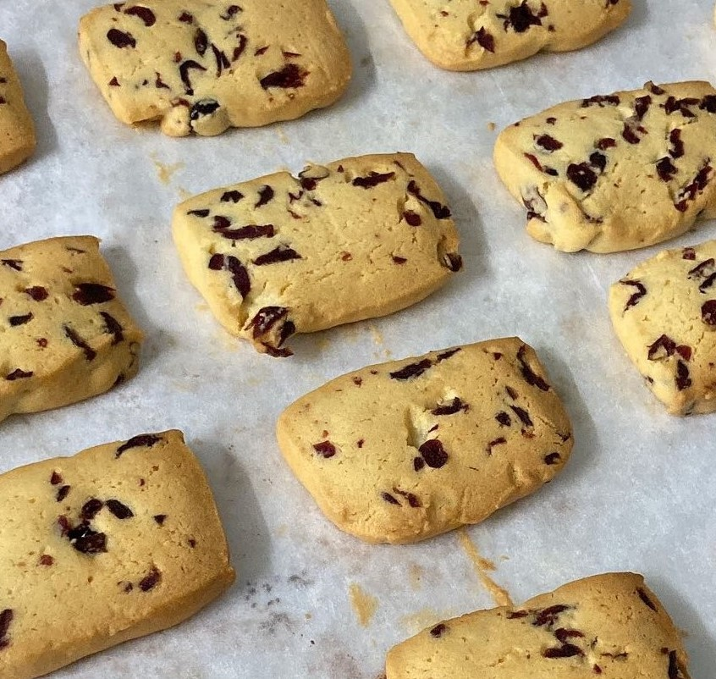
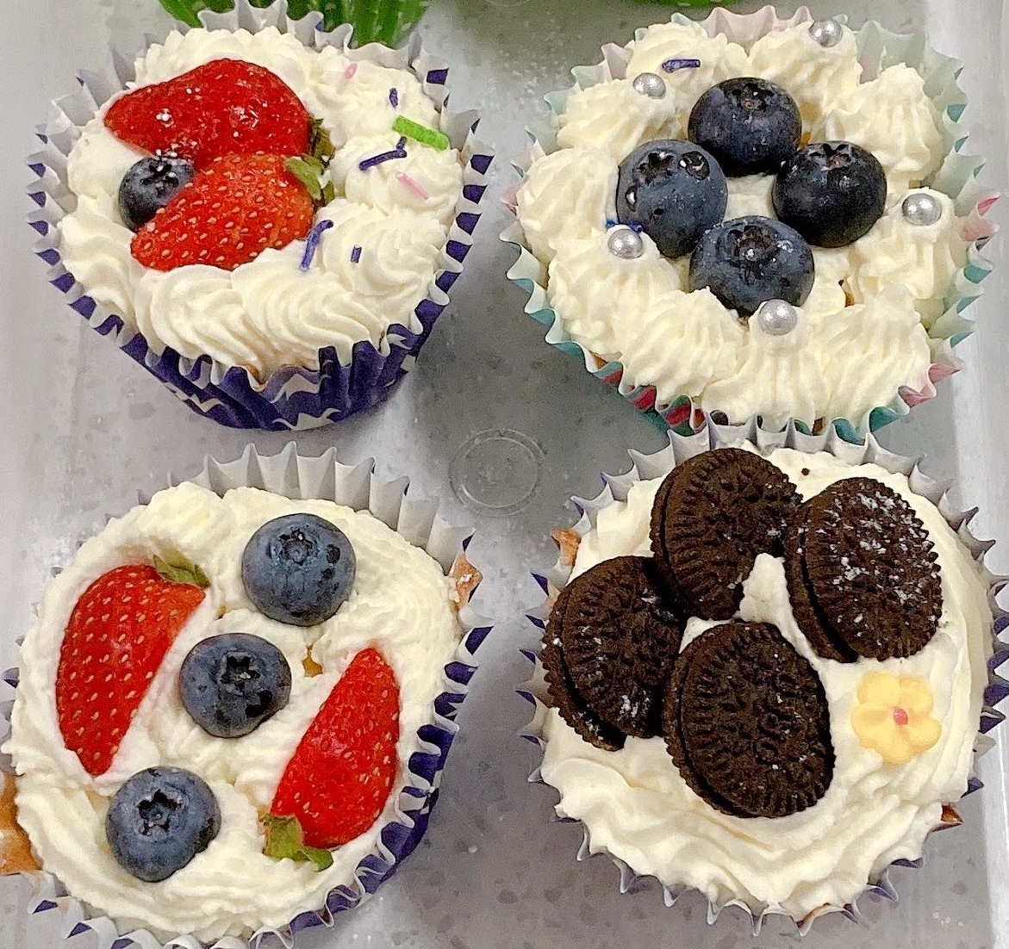
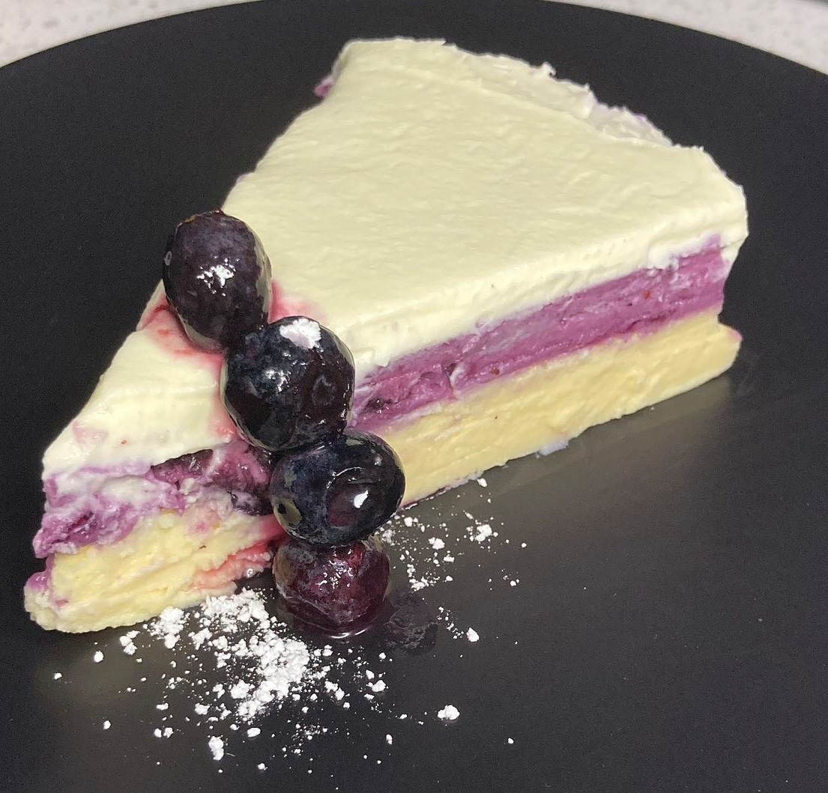
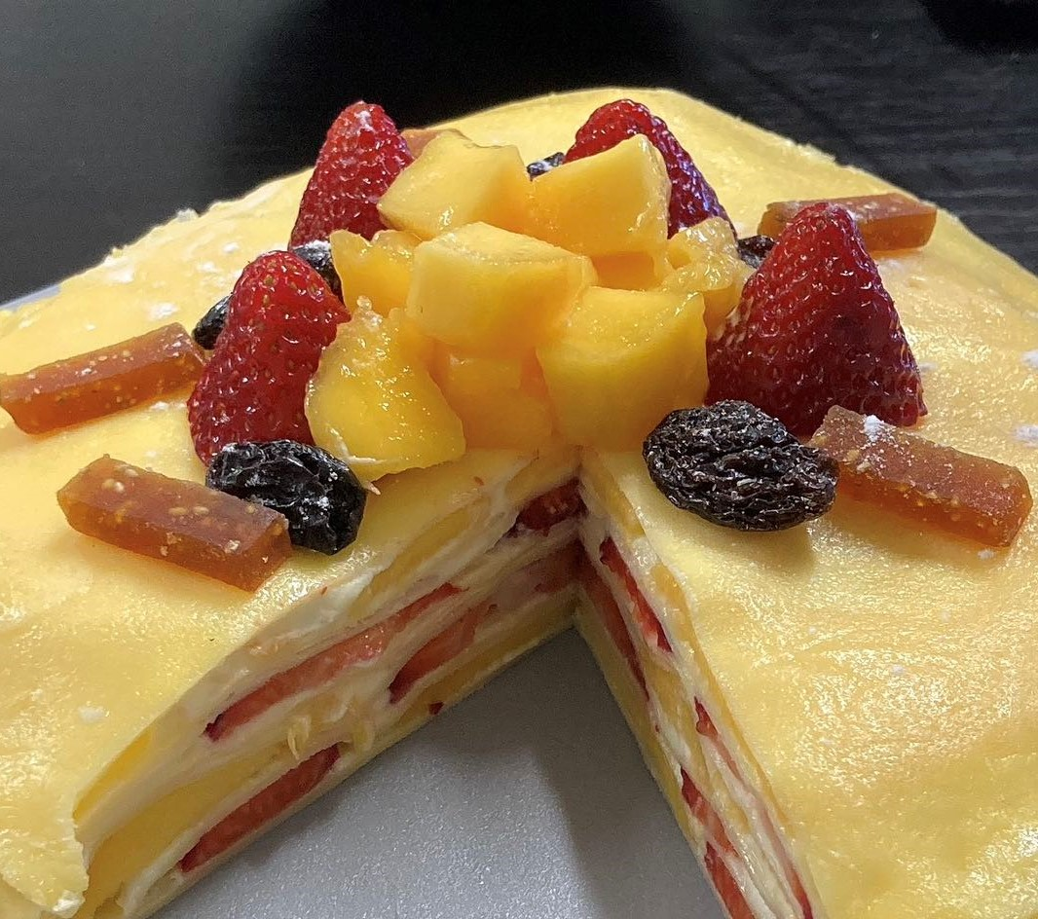
Baking Tools Baking Tips Ingredients Recipe Videos Feedback Search
Welcome to
Judy’s Baking World
I’m Judy, a baking lover and blogger. My goal with this website is to share anything I know about bake and cook, but give you the fun, laughter, confidence is my best wish.

